Slide 1
Xenium Schematics
5/18/26

Slide 2
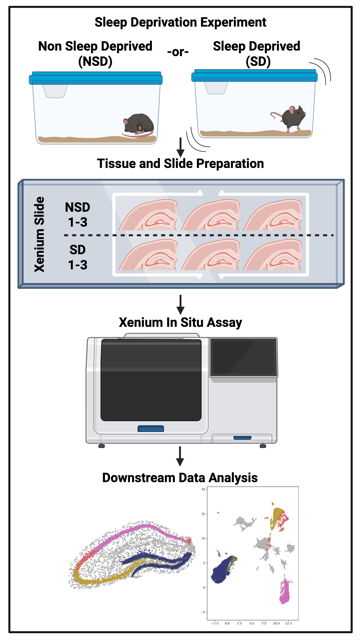
Graphical Abstract

Slide 3
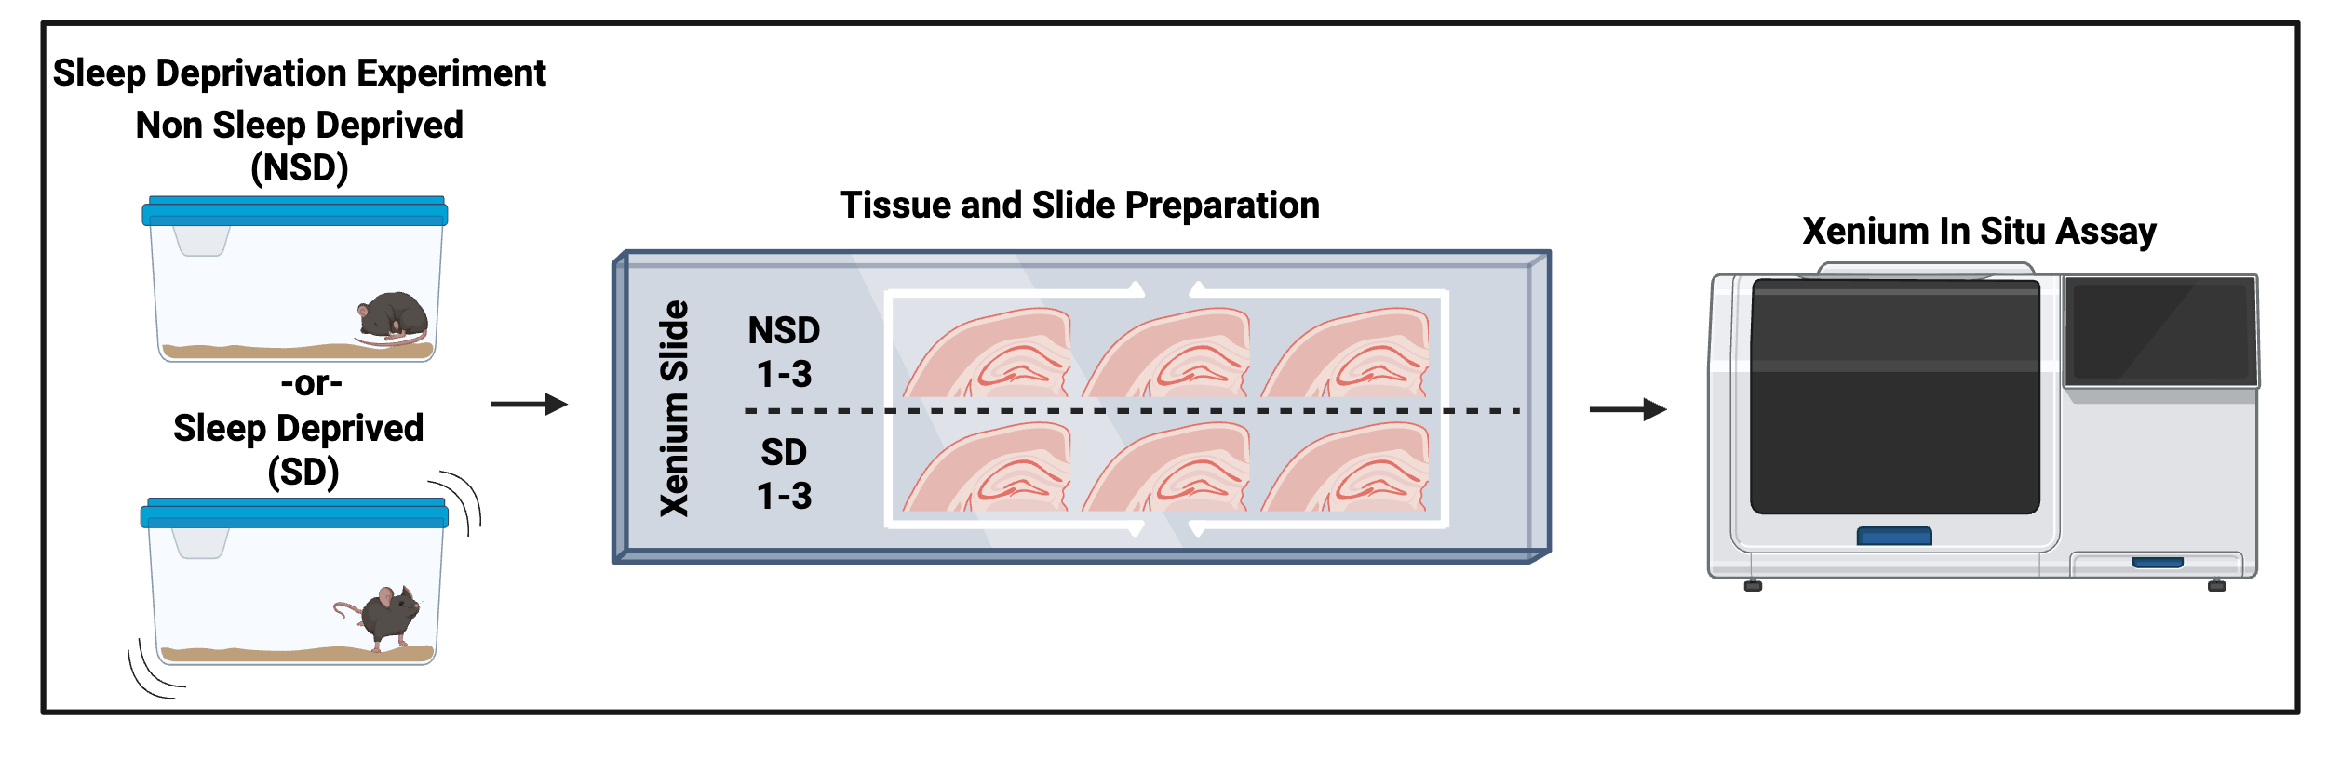
Figure 1a. Schematic

